Slide 1
Unit:
The Dynamic Crust
(Evidence for the ground in motion)
Part I
Plate Tectonics and
Continental Drift Theory

Slide 2
ESSENTIAL QUESTION:
WHAT ARE SOME DIRECT OBSERVATIONS FOR CURRENT MOTIONS IN THE CRUST?
  a.) Occurrence of Earthquakes
  b.) Volcanic eruptions
  What are some indirect observations for past motions in the crust?
  c.) The appearance of folded rock layers
  d.) Faulting in the rock along fault lines
  e. Uplift of the earth’s crust

Slide 3
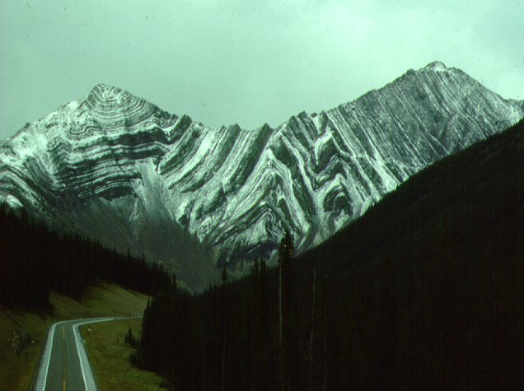
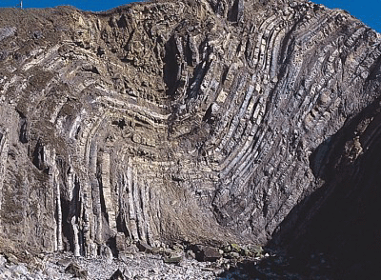
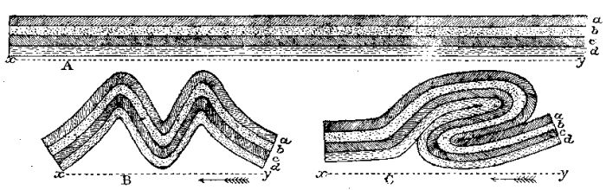
Folding

Slide 4
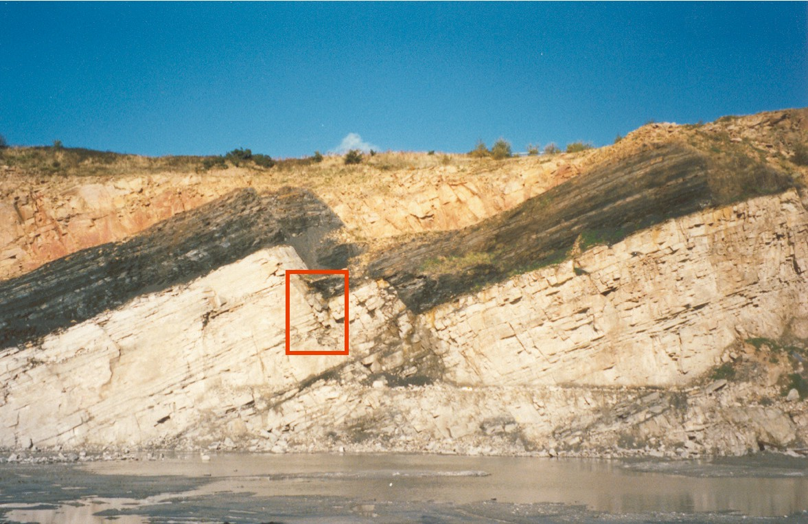
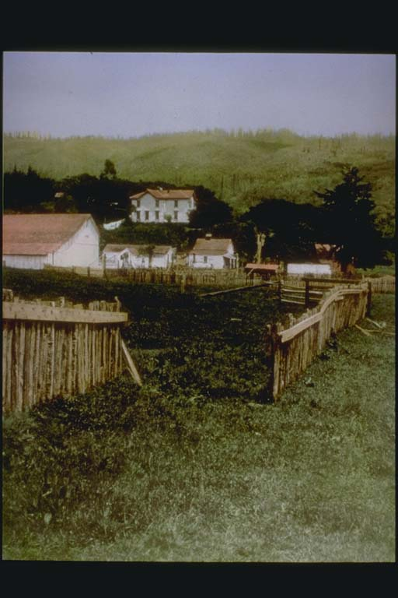
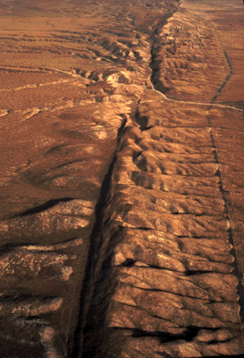
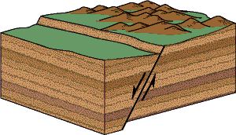
Faulting-Movement along a break

Slide 5
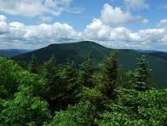
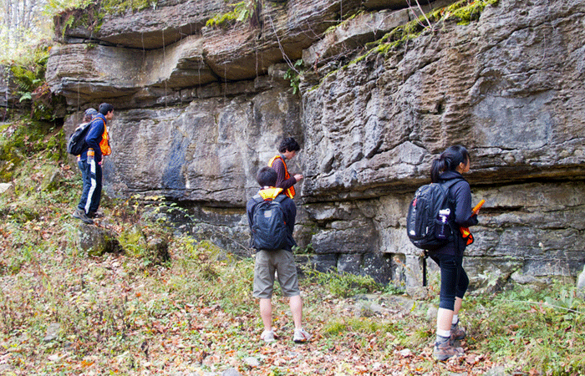
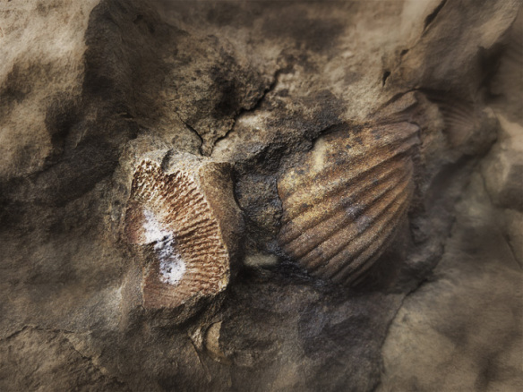
Uplift in the crust:
Example: Catskill “Mountains” – flat lying strata (layers) containing marine fossils at 3,000 feet in altitude!

Slide 6
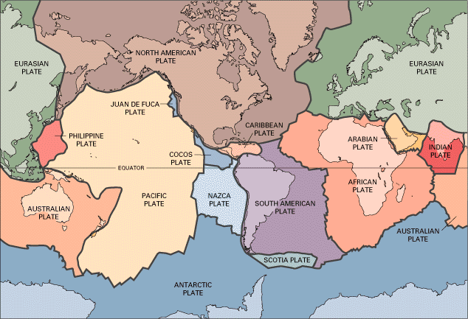
What is the study of Plate Tectonics?
Theory that states that the earth’s lithosphere is divided into sections called plates which move slowly over the more plastic asthenosphere (ductile mantle) over long periods
  2-10 (cm) / year
  On average
  Page 5 ESRT

Slide 7
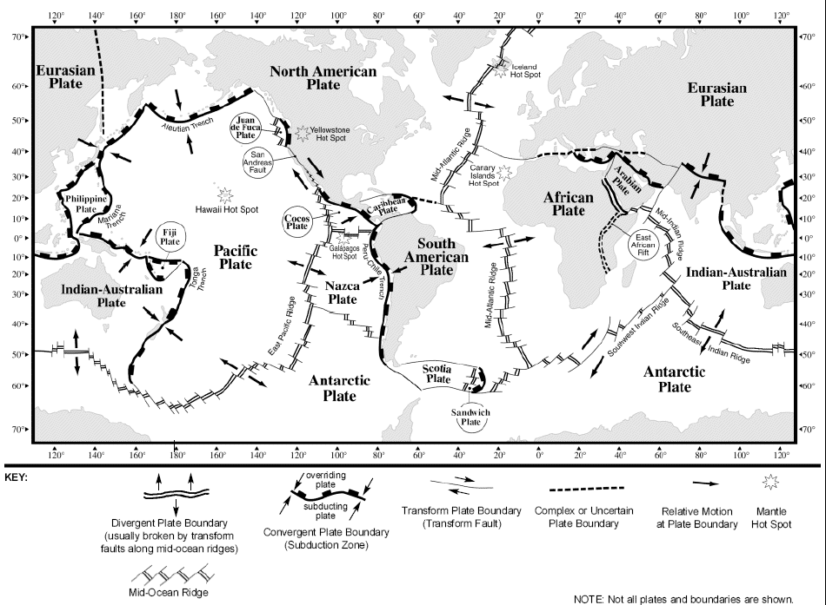
plates include both continental and oceanic crust

Slide 8
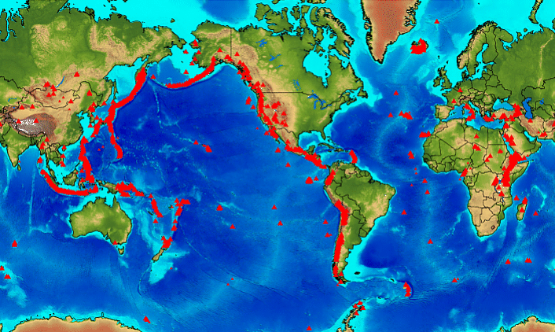
Volcanic Distribution Globally:
Compare the location of Volcanic Activity using Tectonic Plates

Slide 9
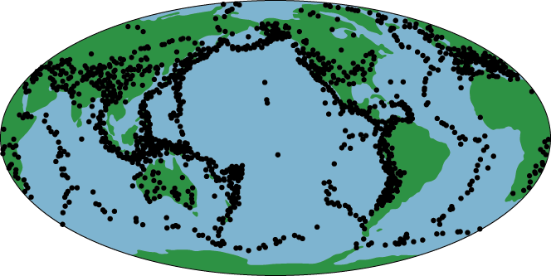
As with volcanoes, earthquakes are not randomly distributed over the globe
Figure showing the distribution of earthquakes around the globe
Active Volcanoes and Earthquakes occur along PLATE BOUNDARIES
Notes:
The black dots on this map of the world depict where earthquake activity is occurring. You can see that, as with volcanoes, the earthquakes are NOT randomly distributed around the globe. Instead they occur in linear patterns associated with plate boundaries.
(Note this diagram of earthquake distribution closely resembles the Pacific Ring of Fire distribution of volcanism).

Slide 10
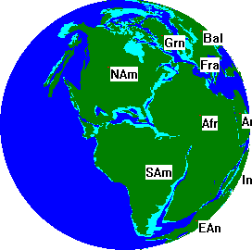
The Continents were not always in the same Locations as they are today
Alfred Wegner and Continental Drift Video (8)
In 1912 Alfred Wegner proposed the Continental Drift Hypothesis
  He suggested that the continents fit together like a jig-saw puzzle and once formed a super-continent called PANGAEA

Slide 11
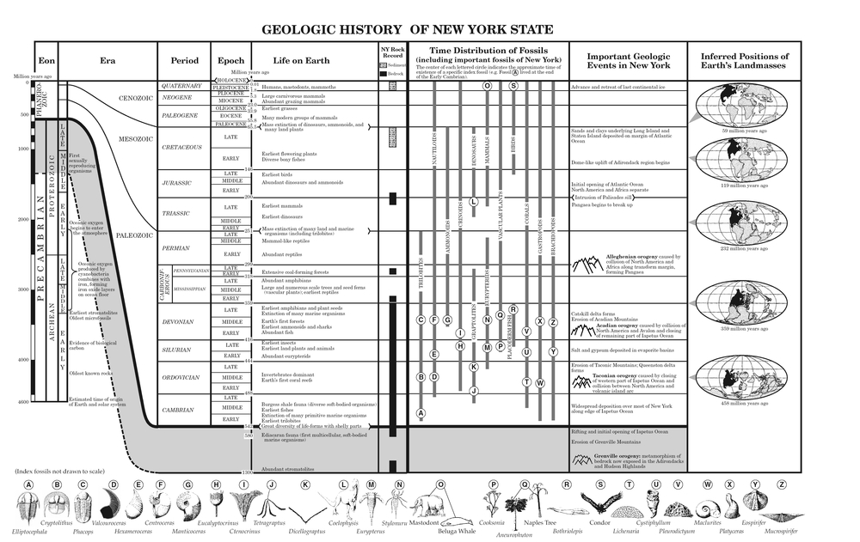

Slide 12
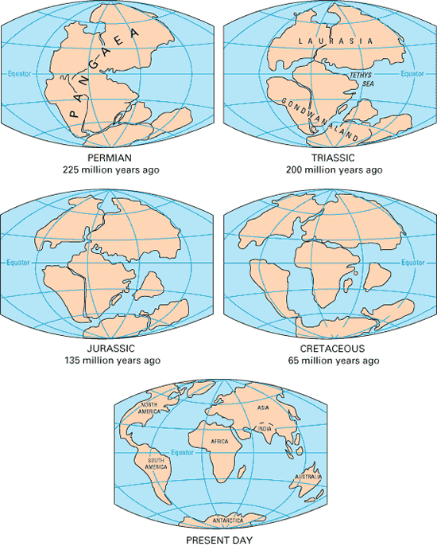
click here for drifting continents animation

Slide 13
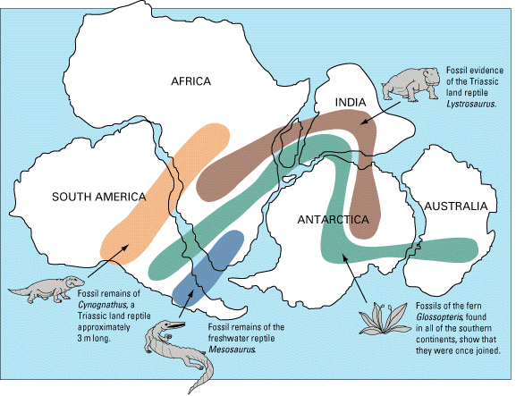
Contributing evidence to continental drift:
1.) Fossils- the distribution of land and plant fossils matched on the continents that are very far apart today

Slide 14
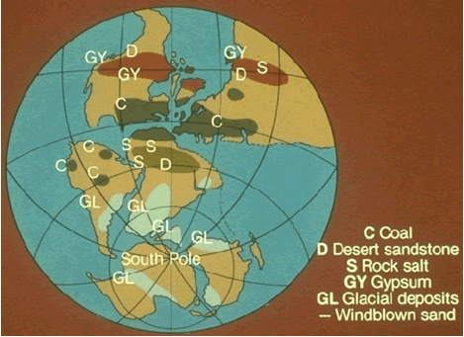
2.) Paleo climate Data:
“Paleo” means PAST
Coal was found in areas today with cool climates (ie: Pennsylvania)
coal is only formed in areas with moist and warm conditions !

Slide 15
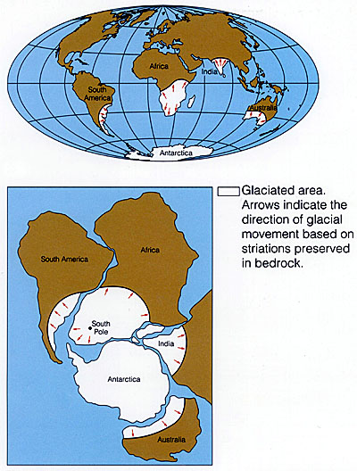
EVIDENCE FOR GLACIATION
-Matching glacial deposits, and striations (scratches) from the dragging of glacial ice across solid rock surfaces- Australia, South Africa, India-currently warmer areas

Slide 16
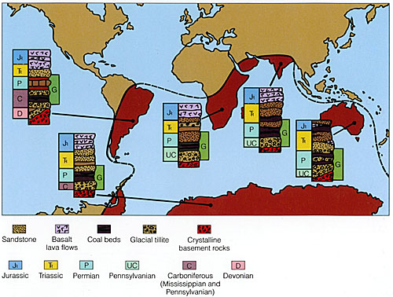
3.) MATCHING ROCK TYPES AND SEQUENCES :The same age and type of sedimentary rock layers matched on adjoining continents

Slide 17
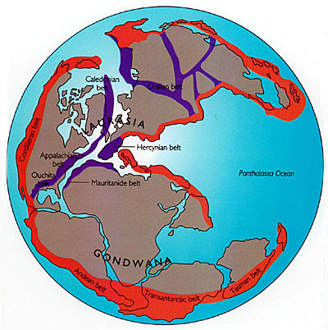
MOUNTAIN BELTS-
EX: PARTS OF THE APPALACHIAN MOUNTAINS EXTEND INTO EUROPE AND AFRICA!

Slide 18
Continental Drift Summary:
The continental drift hypothesis was founded originally based upon the observation that the coastlines of S. America and Africa “fit” together
200-230 mya (million years ago) Pangaea started to break up as North America, Africa, India, and Eurasia moved north
Evidence for continental drift includes:
  Fossil evidence
  Paleo-climate data
    (glacial strations, coal deposits…)
  Rock Types-
    (mountain belts, ages, and same sequences)

Slide 19
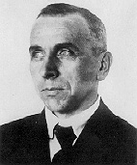
THIS THEORY WASN’T
EXCEPTED UNTIL 1960’S WHY?
Because Wegner could not come up
with an explanation for:
*1.) HOW the continents moved
(he thought the continental crust “plowed” through the oceanic crust)
*2.) WHAT caused their motion
(he thought that Earth’s rotational force caused movement)
Any Ideas…?

Slide 20
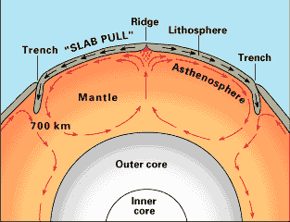
The “WHAT” Missing in Wegner’s Theory: CONVECTION IN THE MANTLE IS THE DRIVING FORCE BEHIND PLATE MOVEMENT!
  Thermal convection cells – ARE DUE TO DIFFERENCES IN DENSITY WITHIN THE EARTH!
    ← Hot (less dense) mantle material rises, moves laterally, driving plates and cooling
    “Cold” (denser) mantle material sinks back into mantle
    convection animation

Slide 21
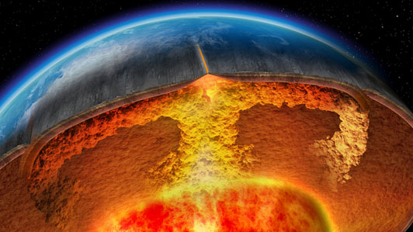
Convection Causes Plate Movement

Slide 22
The Hunt for Evidence Continues:
Seafloor Spreading
Until the mid 1900’s many people believed the oceanic crust was older and flat compared to continental crust
    WRONG!
    Inventions in SONAR mapping and Magnetometers proved that the oceanic crust is more mountainous and YOUNGER than continental crust

Slide 23
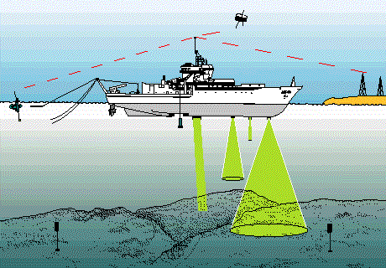
Sonar Mapping- sound waves sent out from ship and reflected off ocean floor

Slide 24
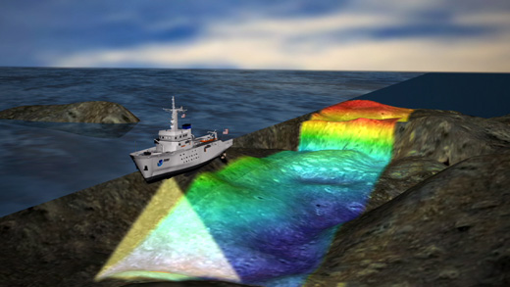
The time it takes for the waves to travel to and from the bottom are used to calculate distance to bottom→ creation of maps

Slide 25
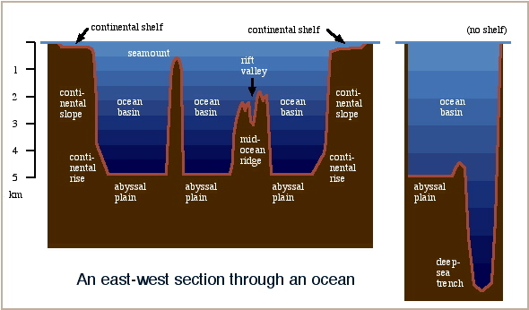
Topography of the Ocean Floor: At Mid Ocean Ridges the oceanic crust splits apart, forming an underwater mountain chain and a rift valley

Slide 26
Evidence of Seafloor Spreading:
1.) The ages of rocks on the seafloor vary at different places
    Basalt samples at or near ocean ridges are youngest
    Rocks at deep sea trenches were the oldest
    (180 million -still younger than continental crust at 3.8 billion )
    New crust is created at ridges, and old crust is destroyed at ocean trenches

Slide 27
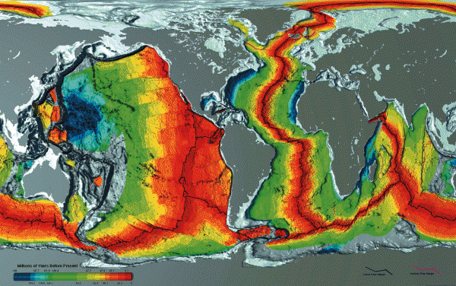
SEAFLOOR SPREADING: ISOCHRON MAP Click for Animation
RED INDICATES NEWER CRUST
BLUE: OLDEST (FURTHEST FROM BOUNDARY)

Slide 28
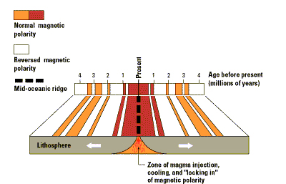
USING PATTERNS OF MAGNETISM TO Prove SEAFLOOR SPREADING
(click for animation)
  Every few or so thousand years the earth reverses polarity (north pole becomes south!).
  Grains of magnetite in basalt “record” this magnetic polarity as the grains align themselves to the magnetic field of earth (normal or reversed).

Slide 29
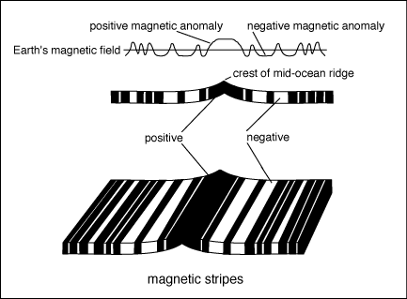
Parallel stripping (changes in magnetism) in igneous rock on both sides of ocean ridges led to further evidence of seafloor spreading
(+)= Normal polarity (-)= Reversed Polarity
        Strong reading weaker reading

Slide 30
In summary…
New basaltic ocean crust is formed at Ocean Ridges
  How? Magma (hot and LESS dense) is forced through crust and fills gap→cools→basalt
Older Crust is destroyed at Ocean Trenches
Seafloor spreading was the “How” that Wegener was missing (continents + oceanic crust= plates not the continents alone)
Convection currents in the mantle support the “WHY” for plate movement

Slide 31
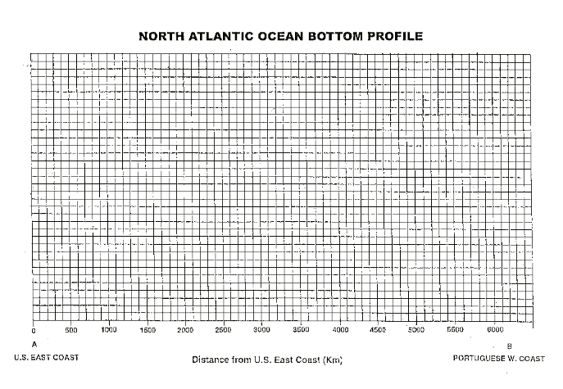
Seafloor Spreading Lab part A

Slide 32
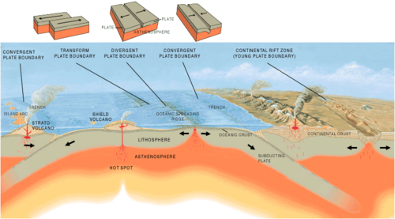
Plate Boundaries:
WHAT HAPPENS AT THE BOUNDARIES BETWEEN THE PLATES?
Some plates move forward, some move backwards, and some even move up and down…

Slide 33
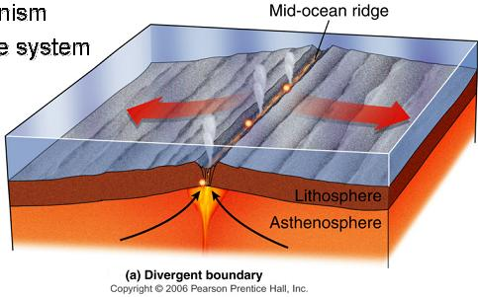
The 3 TYPES OF BOUNDARIES : click here for interactives
1.) Divergent- Spreads apart. NEW CRUST IS FORMED (Basalt) . Forms OCEAN RIDGES
This is how new seas and oceans are formed!
  Seafloor Spreading
  =Opening of the Atlantic in the Mesozoic Era at MAR

Slide 34
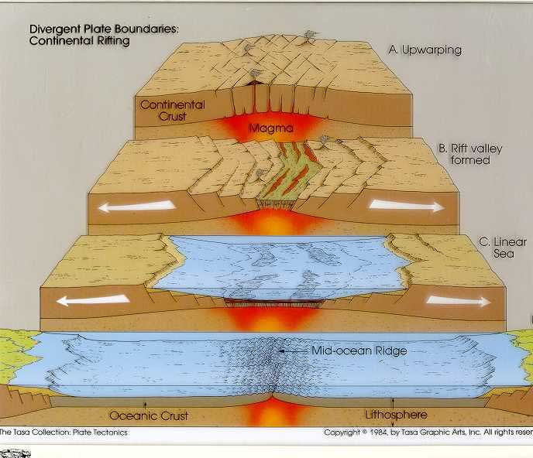

Slide 35
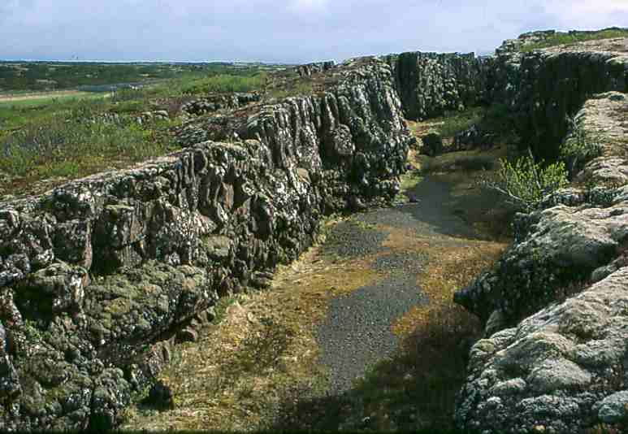
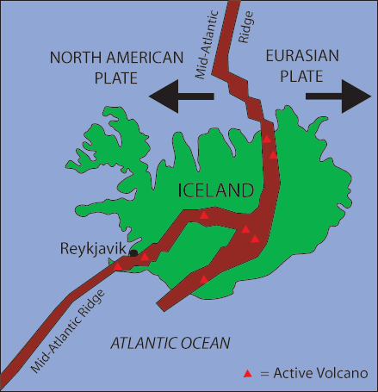
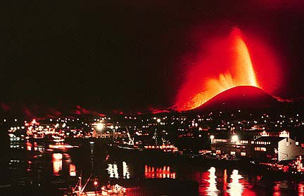
Divergent Boundaries on land:
Iceland has a divergent plate boundary running through its middle
Creates RIFT VALLEYS
Notes:
Iceland is located right on top of a divergent boundary. In fact, the island exists because of this feature.
As the North American and Eurasian plates were pulled apart (see map) volcanic activity occurred along the cracks and fissures (see photographs).
With many eruptions over time the island grew out of the sea!
Question: Why don’t we have islands like Iceland where ever we get an Ocean Ridge?
Answer: Scientists believe that there is a large mantle plume (an upwelling of hot mantle material) located right underneath where Iceland has formed. This would mean that more material would be erupted in the Iceland area compared with if there was just the divergent boundary without the plume underneath it.

Slide 36
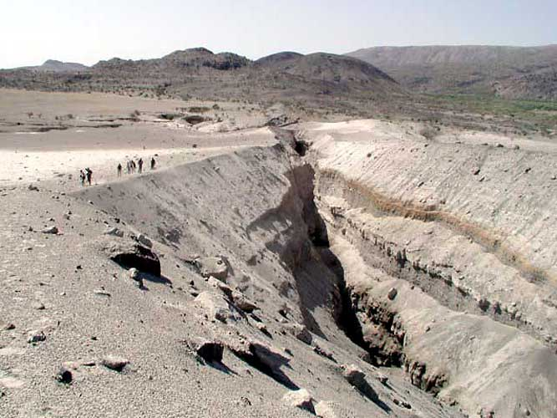
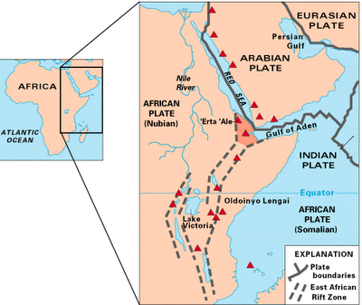
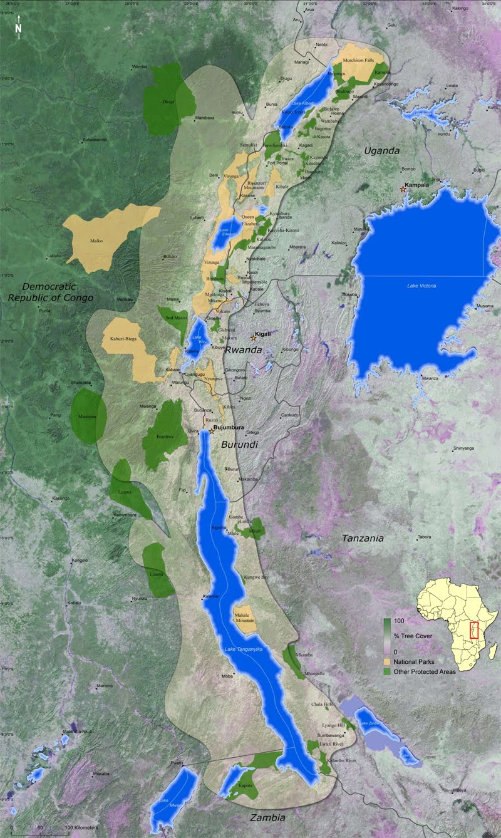
Rift Valley: In Africa
(will form new ocean)

Slide 37
2.)Convergent Boundaries
Are collision zones where crust is destroyed
There are three styles of convergent plate boundaries
  a. Continent-continent collision
  b. Continent-oceanic crust collision
  c. Ocean-ocean collision
Notes:
Convergent boundaries are where the plates move towards each other.
There are three types of convergent boundary, each defined by what type of crust (continental or oceanic) is coming together.
Therefore we can have: continent-continent collision, continent-oceanic crust collision or ocean-ocean collision….

Slide 38
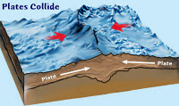
a.) Continent-Continent
Both continental plates have roughly the same density (granite) so they push until they “buckle” forming folded mountains

Slide 39
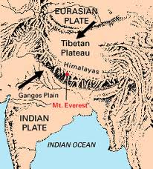
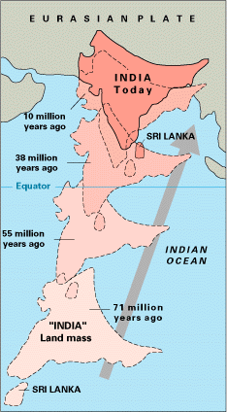
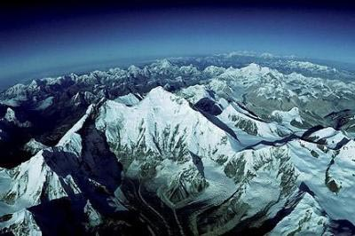
Ex: Himalayan Mountains still growing 5(mm)/year

Slide 40
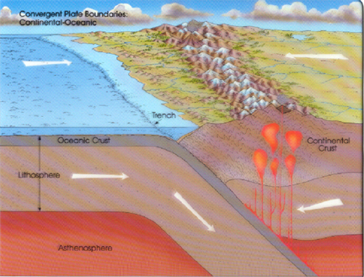
b.) Continent-Oceanic
Oceanic Crust (basalt) is denser than Continental crust (granite).
  When they collide, one will have to sink!
  This is called SUBDUCTION
1.)forms deep sea trenches at collision zones
AND
2.)Active volcanic mountain chains

Slide 41
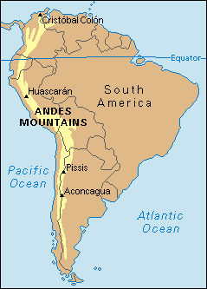
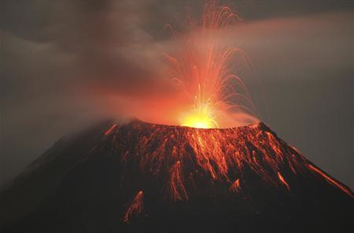
Example: Andes Mountains
As denser oceanic crust sinks and is pulled further downwards it creates a melt
Magma is supplied to volcanic mountains

Slide 42
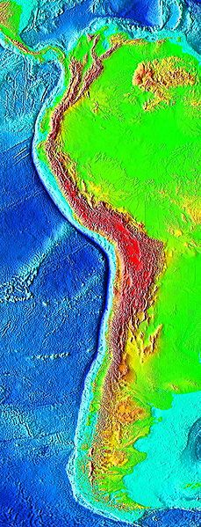
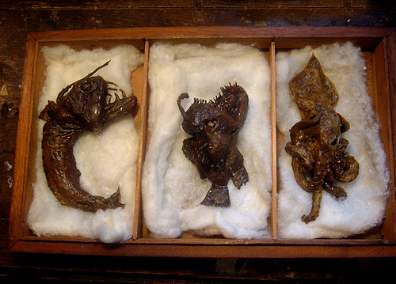

DEEP SEA TRENCHES ARE THE DEEPEST PLACES IN THE WORLD!

Slide 43


c.)Ocean-Ocean Plate Collision
One will sink under another.
The subducting plate is bent downward to form a very deep depression in the ocean floor forming a trench and volcanic island arcs
  E.g. The Mariana Trench is 11 km deep! (Deeper than the height of the Himalayas!)
Notes:
When two oceanic plates converge, because they are dense, one runs over the top of the other causing it to sink into the mantle and a subduction zone is formed.
The subducting plate is bent down into the mantle to form a deep depression in the seafloor called a trench.
Trenches are the deepest parts of the ocean and remain largely unexplored.

Slide 44

Ocean-Ocean collisions also form Volcanic Island Arcs

Slide 45

Example:
Volcanic mountain chain in Alaska

Slide 46



3.) Transform Boundaries- Crust is neither destroyed or created
When two active plates “slide” past one another.
Creates extreme tension from friction
  →leads to faulting AND formation of shallow earthquakes*

Slide 47



Slide 48


Hot Spots: (click for hot spot animation)
Volcanic Island Chains formed from a rising magma plume in the middle of a plate. As plate moves, new islands form
Hawaiian Hot Spots
Click to see video

Slide 49

The Pacific plate has changed direction of movement with time: Evidence= the emperor and Hawaiian hot spot chains!

